Slide 1
Computer Network Lab Experiment 1
TOPIC: COMPUTER HARDWARE
Submitted To,
Jayakrishnan j u
Asst.professor
dept.of mca
Pa aziz college
Submitted By,
Anupama.h.p
PAa20mca-2001
mca s2
PA aziz college
Date of Announcement : 14 May 2021
Date of Submission : 25 May 2021

Slide 2
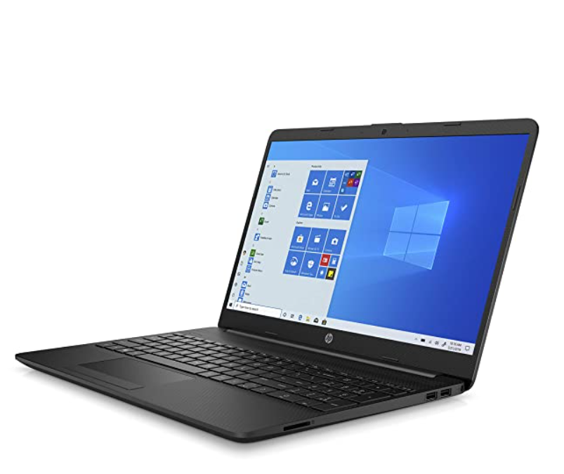
My system configuration
Manufacturer : Acer
Operating System : Windows 8
Screen size:15.6 inches
Resolution :1366 x 768 pixels

Slide 3
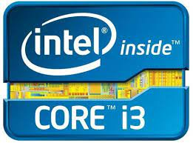
Processor Brand: INTEL
Processor Type: CORE i3
Processor Speed: 3.20GHz

Slide 4
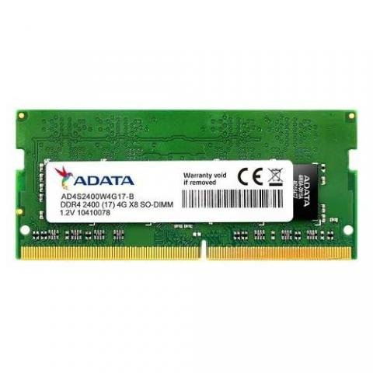
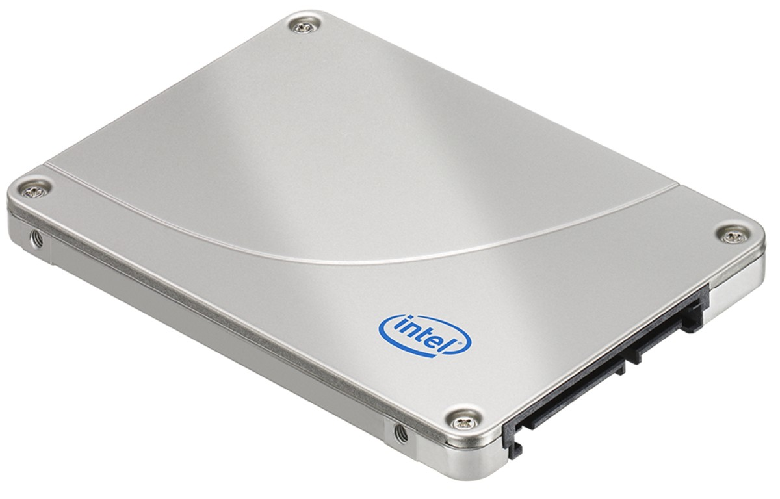
RAM Size :4 GB
Memory Technology :DDR4
Hard Drive Size:512 GB
Hard Disk Description: SSD

Slide 5
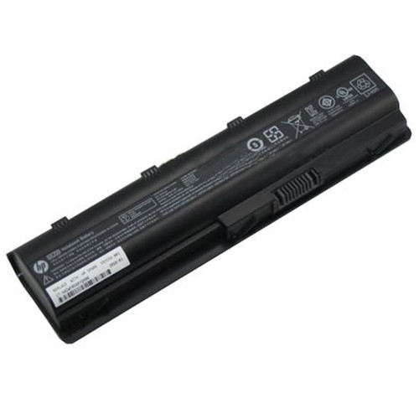
Graphics Chipset Brand :Intel
Graphics Card Description : Integrated
USB 3.0 Ports:2
HDMI Ports:1
Battery:1 Lithium ion batteries

Slide 6
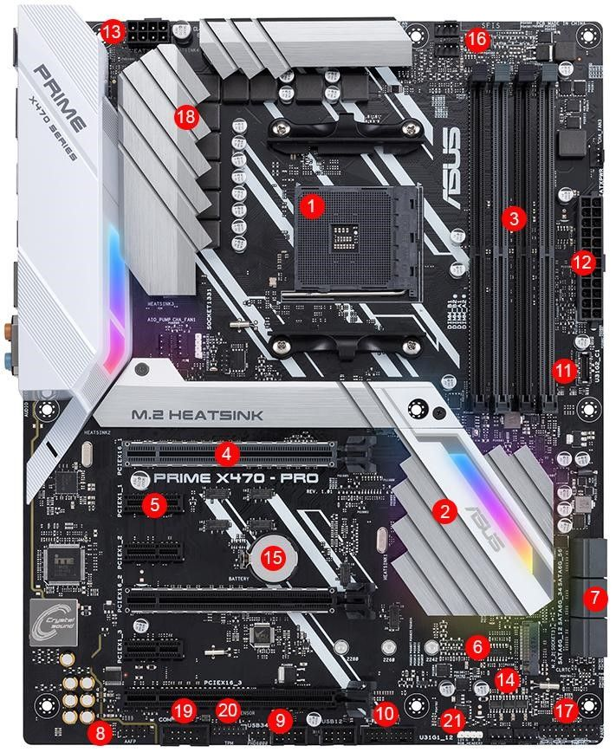
Motherboard

Slide 7
1. CPU socket | 2. Chipset | 3. DIMM/RAM slots
4. PCIe x16 slot | 5. PCI x1 slot | 6. M.2 connector
7. SATA ports | 8. Front panel connectors | 9. USB 2. header
10. USB 3.1 Gen1 header | 11. USB 3.1 Gen2 header | 12. ATX power connector
13. CPU power connector | 14. BIOS chips | 15. CMOS battery
16. Fan headers | 17. Front panel header | 18. VRM heatsink
19. COM/Serial header | 20. TPM header | 21. RGB header

Slide 8
1.Hard Drive Connectors
Generally, a motherboard has at least two hard drive connectors.
Current motherboards use Serial Advanced Technology Attachment (SATA) hard drive connectors, which have L-shaped curves to ensure that cables are connected in the correct direction.
The older Integrated Drive Electronics (IDE) connector uses two rows of 20 pins each.
Some motherboards have connectors for both SATA and IDE drives.
The computer's CD or DVD drive also connects to an IDE or SATA interface.

Slide 9
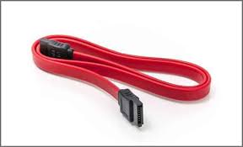
1.1 SATA
The SATA technology itself is a connecter interface primarily used for computer bus connections in storage applications.
In this application, the cables are used to connect a mass storage device (e.g. hard disk drives, optical drives, solid-state memory drives) to a host bus adapter such as a motherboard.

Slide 10
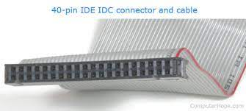
1.2 IDE
IDE, an acronym for Integrated Drive Electronics, is a standard type of connection for storage devices in a computer.
Generally, IDE refers to the types of cables and ports used to connect some hard drives and optical drives to each other and to the motherboard.

Slide 11
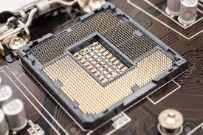
2.CPU socket
A CPU socket uses a series of pins to connect a CPU’s processor to the PC’s motherboard.
If a CPU is connected via a CPU socket, it is not soldered and can therefore be replaced.
CPU sockets are more common with desktop pc’s than they are on laptop.

Slide 12
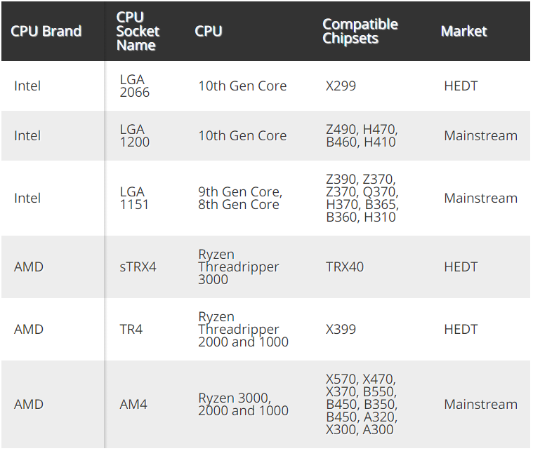
Intel and AMD CPU Sockets

Slide 13
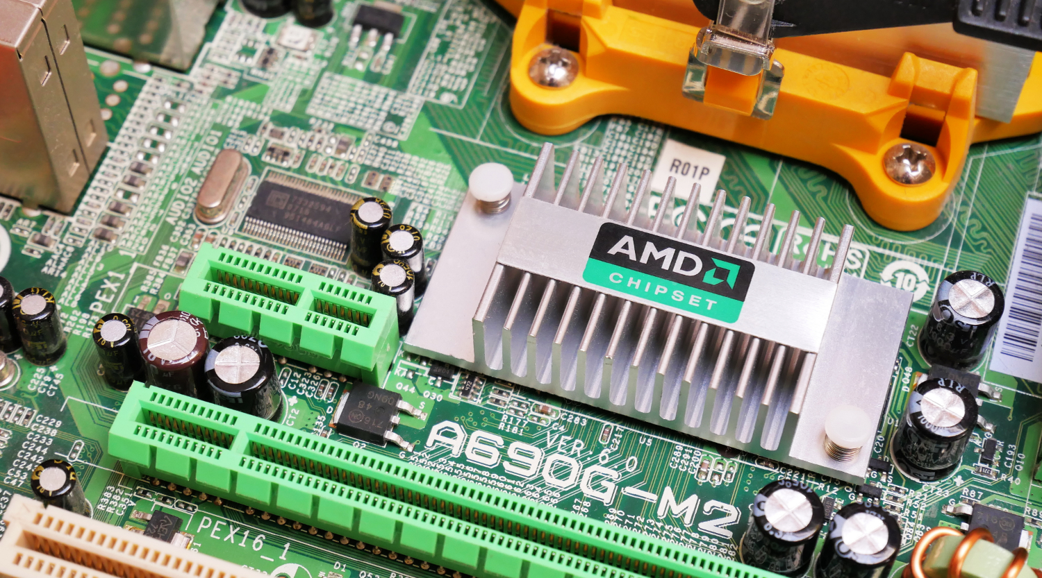
3. CHIPSET
Living on the motherboard, a PC's chipset controls the communication between the CPU, RAM, storage and other peripherals.
The chipset determines how many high-speed components or USB devices your best motherboard can support.

Slide 14
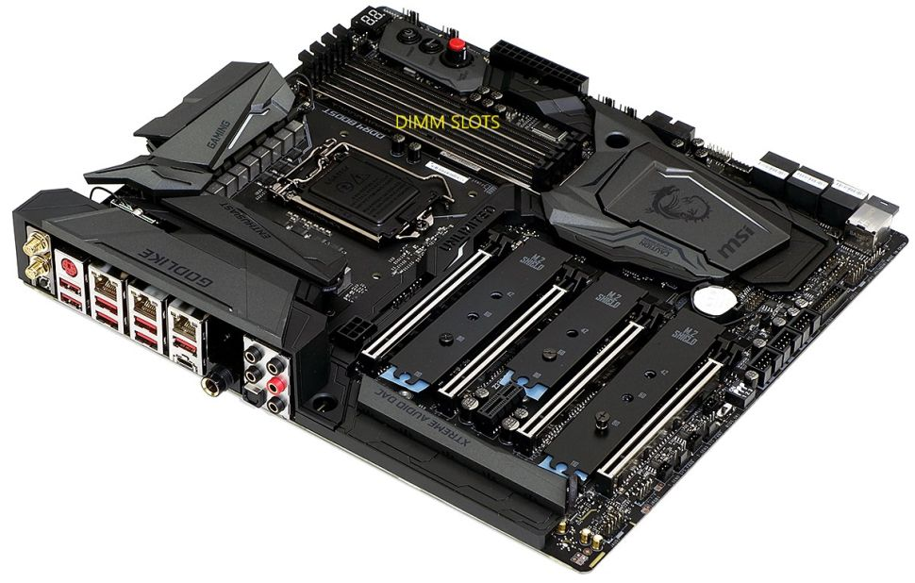
4.DIMM/RAM slots
DIMM (dual in-line memory module) slots are the place on your motherboard where the RAM goes.
As such, you may also see DIMM slots referred to as “RAM slots.”

Slide 15
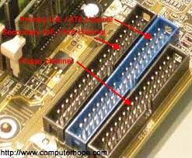
5.Floppy Drive Connector
Although few modern computers use floppy drives for storage, many motherboards continue to include floppy drive connectors to support legacy devices.
A floppy drive connector has two rows of 17 pins each.

Slide 16
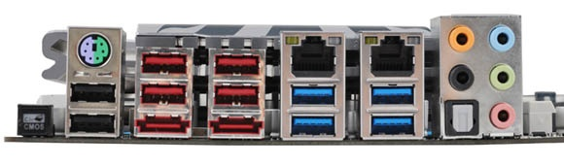
6.Peripheral Connectors
Motherboards have connectors for different types of peripherals, usually located on a back plane that remains exposed on the back of the computer case when the tower is closed.
The most common peripheral connection is the Universal Serial Bus (USB) connection, while some motherboards also have connections for audio speakers along with ports for FireWire, serial and parallel devices.
Some motherboards have additional "headers," or banks of pins, that can be used to connect additional peripheral ports on the front of the computer case.

Slide 17
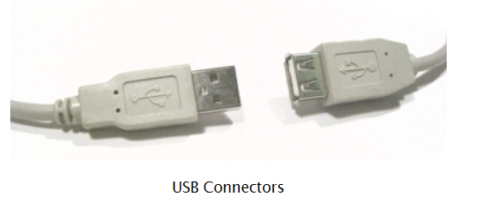
6.1 USB
USB (Universal Serial Bus) is a serial bus standard to interface devices.
USB was designed to allow many peripherals to be connected using a single standardized interface socket and to improve the plug-and-play capabilities by allowing devices to be connected and disconnected without rebooting the computer.
Other convient features include providing power to low-consumption devices without the need for an external power supply and allowing many devices to be used without requiring manufacturer specific, individual device drivers to be installed.
USB is by far the dominating bus for connecting external devices to your computer.

Slide 18
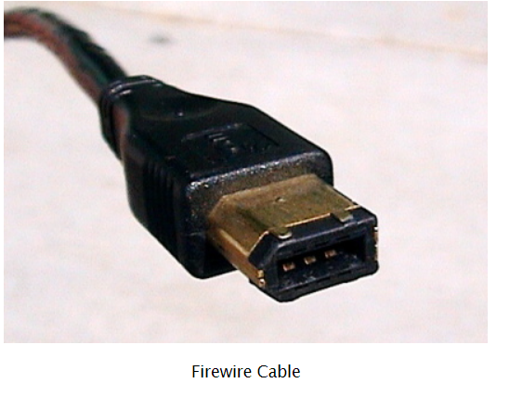
6.2 Firewire
Firewire (technically known as IEEE 1394 and also known as i.LINK for Sony) is a serial bus interface standard for high-speed communications and isochronous real-time data transfer, frequently used in a personal computer.
Firewire has replaced Parallel ports in many applications.
It has been adopted as the High Definition Audio-Video Network Alliance (HANA) standard connection interface for A/V (audio/visual) component communication and control.
Almost all modern digital camcorders have included this connection.

Slide 19
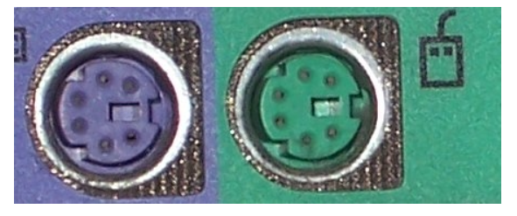
6.3 PS/2
The PS/2 connector is used for connecting some keyboards and mice to a PC compatible computer system.
The keyboard and mouse interfaces are electrically similar with the main difference being that open collector outputs are required on both ends of the keyboard interface to allow bidirectional communication.
If a PS/2 mouse is connected to a PS/2 keyboard port, the mouse may not be recognized by the computer depending on configuration.

Slide 20
7.Add-on Card Connectors
Many motherboards have connectors for computer add-on cards.
These connectors are long slots into which the cards are inserted.
There are several types of add-on card connectors.
Some of the most common include Peripheral There Component Interconnect Express (PCIe) and Accelerated Graphics Port (AGP), used mainly for video cards, and conventional Peripheral Component Interconnect (PCI), used for other types of add-on cards such as sound cards and storage controllers.

Slide 21
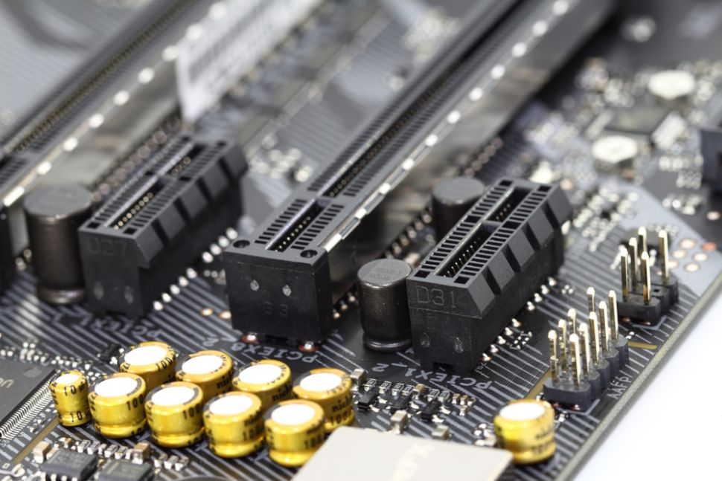
7.1 PCIe x16 slot
PCIe (peripheral component interconnect express) is an interface standard for connecting high-speed components.
Every desktop PC motherboard has a number of PCIe slots you can use to add GPUs (aka video cards aka graphics cards), RAID cards, Wi-Fi cards or SSD (solid-state drive) add-on cards.

Slide 22
8.Power Connector
Every motherboard has at least one power connector.
This connector is used to bring power from the computer's main power supply to all of the computer's components.
Because some of today's desktop computers have very high power requirements, some motherboards have additional ports for auxiliary power connectors.

Slide 23
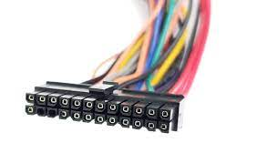
8.1 ATX power connector
ATX power connectors are designed to connect a computer's power supply to an ATX motherboard.
They are constructed of metal pins laid throughout a nylon matrix.
A female type ATX power connector extends from the ATX power supply to plug into the motherboard.

Slide 24
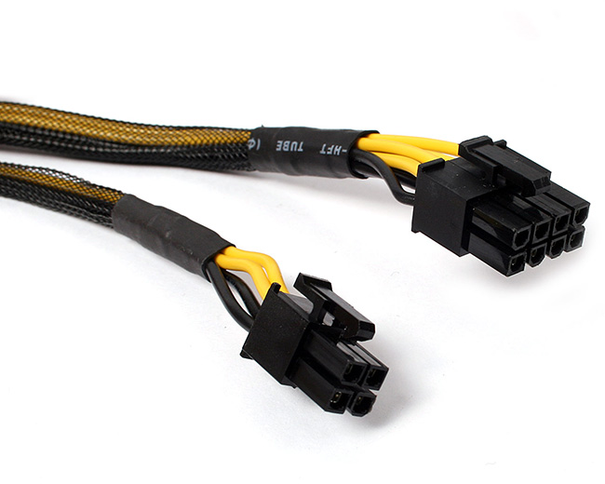
8.2 CPU power connector
At some point in time the motherboard’s pins were no longer sufficient to provide the processor (cpu) with power.
With overclocked cpu’s drawing as much as 200W a need to provide power directly to the CPU was created.
Nowadays it is the P4, or EPS connector, to provide the cpu with power.

Slide 25
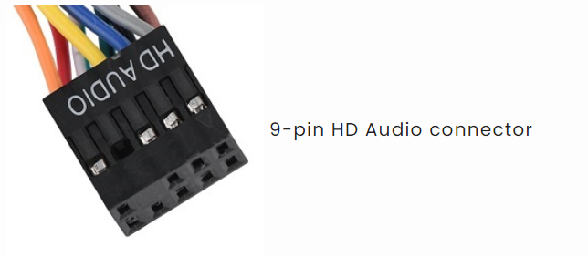
9.Case Connectors
On the side of the motherboard closest to the front of the computer case are the case connectors, a bank of pins to which very small wires attach.
The case connectors are used for the power and status lights on the front of the computer case, as well as the power button that turns the computer on.

Slide 26
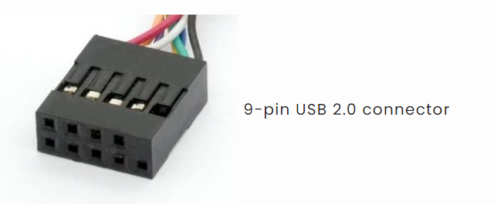
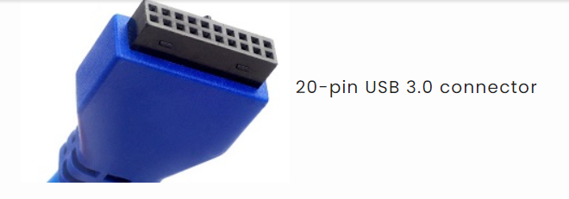
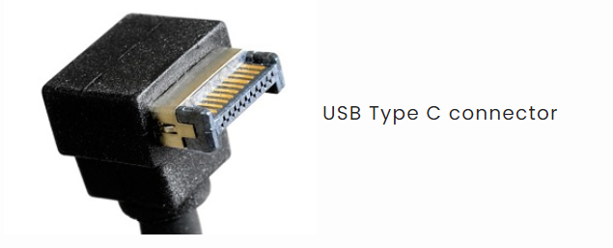
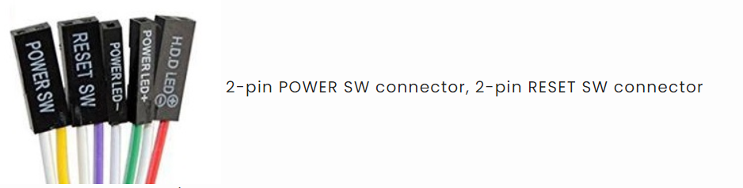

Slide 27
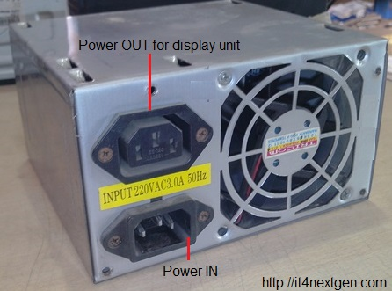
SMPS and Cabinet
SMPS or switched mode power supply is an electronics device that is used to convert AC to DC, AC to AC, DC to DC and DC to AC voltages.
The circuit consists of transformer, rectifier, voltage regulator and a filter.
The input supply is turned On and Off by MOSFETs and outputs a high efficiency, regulated voltage.
The SMPS used in computers is of AC to DC type supply.

Slide 28
SMPS PARTS
Power-IN - The power-IN connector as shown in the figure is the input for MAINS supply. A power cable is inserted here, the other end of which is connected to mains supply. The input supply gets converted to DC supply.
Power-OUT- The power-OUT connector is connected directly to the Power-IN connector from inside the supply unit. It supplies the same AC supply that is fed to power-IN socket. The power-OUT connector is used to give supply to monitors or any display unit.
FAN- If you look at the back side of Computer-SMPS, you will find a FAN at the right side. The FAN as you can see, blows the air out and is only used to dissipate the internal heat from the SMPS since the switching is done at high frequencies which create a lot of heat inside.

Slide 29
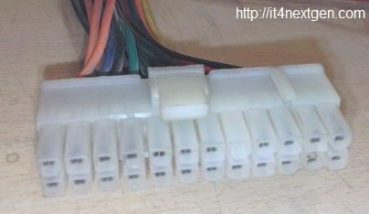
SMPS CONNECTORS
ATX connector
As you can see in the image, it is a 24-pin female connector which is used to supply DC supply to the motherboards. Various color-coded wires connect to this connector and each colored wire supplies distinct DC voltage which is explained in the chart below.

Slide 30
Wire color | DC Voltage
Red | +5V
Yellow | +12V
Black | Ground
Blue | -12V
Green | Power On
Grey | Power Good
Purple | +5V StandBy
Orange | +3.3V
Brown/Orange | +3.3V Sense
White | -5V (optional)

Slide 31
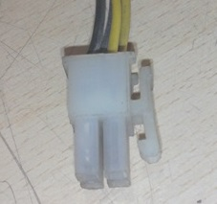
ATX-12V connector
Latest SMPS power supplies are accompanied by an extra 4-pin connector which supplies 12 volts to energize the central processing unit and other components of the motherboard.

Slide 32
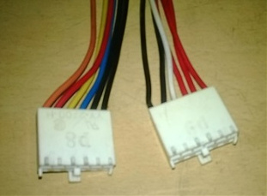
AT Connectors
Earlier motherboards used to support AT connectors( 6-pin each) also called P8 and P9 connectors to supply power to these motherboards(upto 486 boards).

Slide 33
Wire Color | DC Voltage
Red | +5 V
White | -5V
Black | Ground or OV
Blue | -12 V
Yellow | +12V
Orange | +5 V(PG)

Slide 34
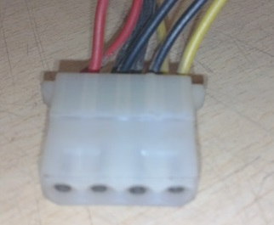
4-PIN connectors
There are multiple 4-pin connectors that draw out from the SPMS unit. These connectors are used to supply DC power to various peripherals of computer like a floppy disk drive, hard disk drive or DVD-writers.

Slide 35
Wire colour | DC Voltage | Used For
Yellow | +12V | Motors
Black | GND
Black | GND
Red | +5V | Logic circuit

Slide 36
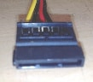
SATA-output connector
To feed the power to latest SATA hard drives, these connectors are used.

Slide 37
IntroductiOn TO computer hardware
Computer hardware is the physical components of a computer that we can touch and feel. These are machinery or primary electronic devices that are used to build up the computer or data processing system. Computer hardware consists of interconnected electronic devices that we can use to control a computer’s operation, input and output.
Computer hardware examples:
Few examples of computer hardware are –
Motherboard – it is the circuit board that contains IC sockets and slots.
Central Processing Unit (CPU) – it is the heart of the computer
Peripheral of CPU such as Keyboard, Mouse, Monitor, Printer, Speaker, UPS etc.

Slide 38
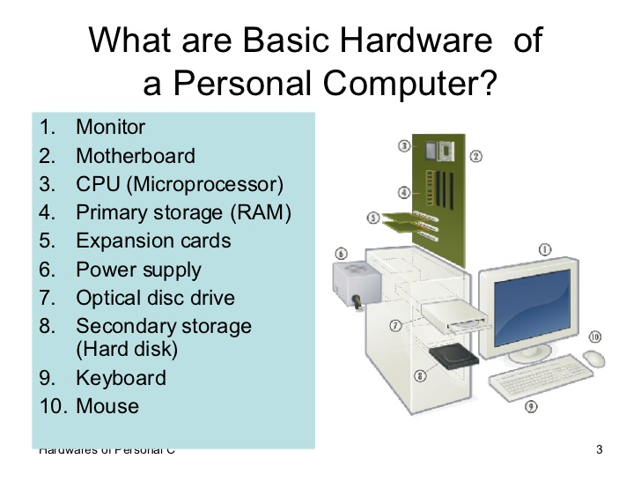

Slide 39
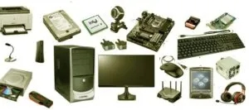
Types of computer hardware
Input devices
Cpu
Output devices

Slide 40
Input devices
Following are some of the important input devices which are used in a computer −
Keyboard
Mouse
Joy Stick
Light pen
Track Ball
Scanner
Graphic Tablet
Microphone
Magnetic Ink Character Reader(MICR)
Optical Character Reader(OCR)
Bar Code Reader
Optical Mark Reader(OMR)
An input device is any hardware device that sends data to a computer, allowing you to interact with and control it.

Slide 41
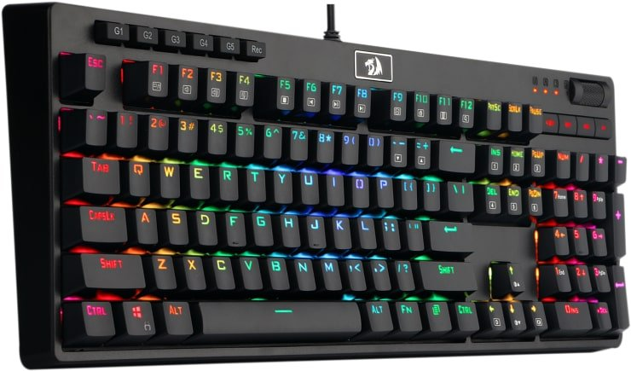
1. KEYBOARD
The keyboard is one of the most important parts of computer.
The keyboard is designed to input the data by typing letters, symbols, numbers (ABC,123,!@#). The keyboard is used for writing work on the computer.
The shape of the keyboard is rectangular and the buttons are arranged horizontal contains about 108 Keys.
These keys allowing us to the entry of information encoded into the computer system by pressing the keys.

Slide 42
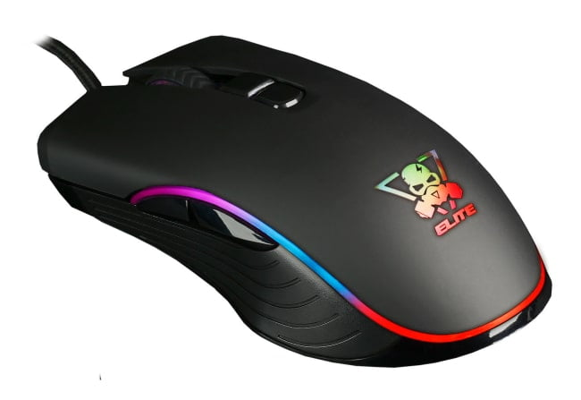
2. MOUSE
The mouse is an input device also known as a pointing device of a computer.
Its main function to facilitate user interaction with the monitor screen of the computer as like the keyboard.
A mouse is a device connected to a computer for controlling the cursor on the screen.
The control is detected by the mouse when it is moving it along on the flat surface on which it is located, as well as by pressing the buttons that located on the upper surface of the device and scrolling the wheel, which, as a rule, is located between the control buttons.

Slide 43
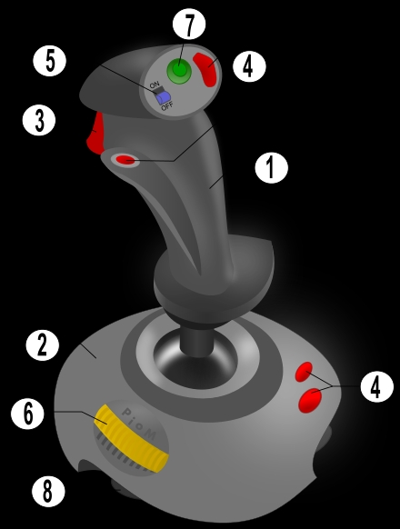
3. Joystick
A joystick is an input device consisting of a stick that pivots on a base and reports its angle or direction to the device it is controlling. a joystick, also known as the control column, is the principal control device in the cockpit of many civilian and military aircraft, either as a centre stick or side-stick. it often has supplementary switches to control various aspects of the aircraft's flight.
Possible elements of
game joystick: 1. stick, 2. base, 3. trigger, 4. extra buttons, 5. autofire switch, 6. throttle, 7. hat switch (pov hat), 8. suction cups.

Slide 44
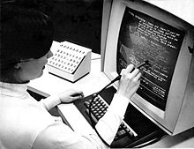
4. LIGHT PEN
A light pen is a computer input device in the form of a light-sensitive wand used in conjunction with a computer's cathode-ray tube (CRT) display.
Photo of the Hypertext Editing System(HES) console in use at Brown University, circa October 1969.
The photo shows HES on an IBM 2250 Mod 4 display station, including lightpen and programmed function keyboard, channel coupled to Brown's IBM 360 mainframe.
It allows the user to point to displayed objects or draw on the screen in a similar way to a touchscreen but with greater positional accuracy.
A light pen can work with any CRT-based display, but its ability to be used with LCDs was unclear (though Toshiba and Hitachi displayed a similar idea at the "Display 2006" show in Japan..

Slide 45
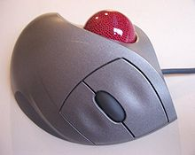
5. TRACKBALL
A trackball is an input device used to enter motion data into computers or other electronic devices.
It serves the same purpose as a mouse, but is designed with a moveable ball on the top, which can be rolled in any direction.
instead of moving the whole device, you simply roll the moveable ball on top of the trackball unit with your hand to generate motion input.
Designed for computers generally serve as mouse replacements and are primarily used to move the cursor on the screen.
like mice, computer trackball devices also include buttons, which can serve as left-click and right-click buttons, and may also be used to enter other commands.

Slide 46
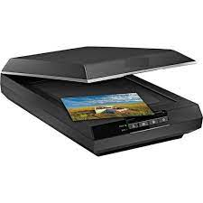
6.SCANNER
A scanner is an input device that captures documents such as photographs and text.
Scanners are of many types according to their design, scanning mechanisms etc.
When a document is to be scanned, firstly a documents is converted into digital signal and then scanning is performed on this electronic version of document.
A scanner can be connected to computer using different interface such as SCSI, TWAIN etc, but today the most common method is USB cable.

Slide 47
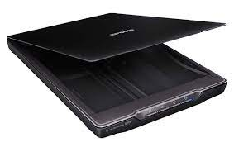
FLATBED SCANNER
Flatbed scanners, also called desktop scanners, are the most versatile and commonly used scanners.
A scanner that provides a flat, glass surface to hold a sheet of paper, book or other object for scanning.
Flatbed scanners often come with sheet feeders for scanning multiple sheets of paper rather than one at a time.

Slide 48
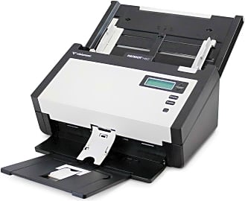
SHEET-BED SCANNER
Sheet-fed scanners are similar to flatbed scanners except the document is moved and the scan head is immobile.
A sheet-fed scanner looks a lot like a small portable printer.

Slide 49
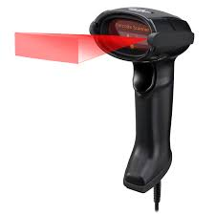
HANDHELD SCANNERS
Handheld scanners use the same basic technology as a flatbed scanner, but rely on the user to move them instead of a motorized belt.
This type of scanner typically does not provide good image quality. However, it can be useful for quickly capturing text.

Slide 50
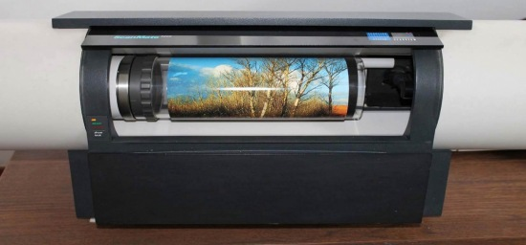
DRUM SCANNER
Drum scanners are used by the publishing industry to capture incredibly detailed images.
They use a technology called a photomultiplier tube (PMT). In PMT, the document to be scanned is mounted on a glass cylinder.
At the center of the cylinder is a sensor that splits light bounced from the document into three beams.
Each beam is sent through a color filter into a photomultiplier tube where the light is changed into an electrical signal.

Slide 51
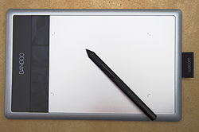
7. GRAPHIC TABLET
A graphics tablet (also known as a digitizer, drawing tablet, drawing pad, digital drawing tablet, pen tablet, or digital art board) is a computer input device that enables a user to hand-draw images, animations and graphics, with a special pen-like stylus, similar to the way a person draws images with a pencil and paper.
These tablets may also be used to capture data or handwritten signatures.
it can also be used to trace an image from a piece of paper that is taped or otherwise secured to the tablet surface.
Capturing data in this way, by tracing or entering the corners of linear polylines or shapes, is called digitizing.

Slide 52

8.MICROPHONE
A microphone, colloquially called a mic or mike is a device – a transducer – that converts sound into an electrical signal.
microphones are used in many applications such as telephones, hearing aids, public address systems for concert halls and public events, motion picture production, live and recorded audio engineering, sound recording, two-way radios, megaphones, radio and television broadcasting.
They are also used in computers for recording voice, speech recognition, voip, and for non-acoustic purposes such as ultrasonic sensors or knock sensors.

Slide 53
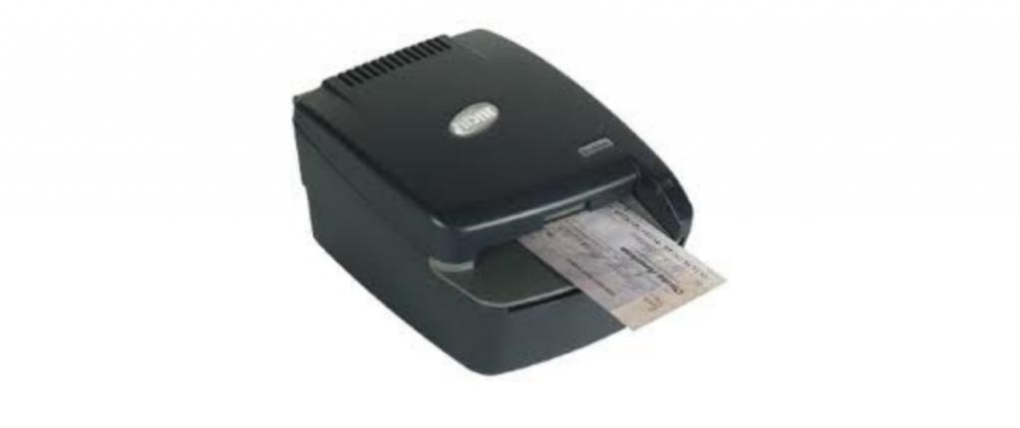
9. MAGNETIC INK CHARACTER READER (MICR)
Magnetic ink character recognition code, known in short as micr code, is a character recognition technology used mainly by the banking industry to streamline the processing and clearance of cheques and other documents.
Micr encoding, called the micr line, is at the bottom of cheques and other vouchers and typically includes the document-type indicator, bank code, bank account number, cheque number, cheque amount (usually added after a cheque is presented for payment), and a control indicator.
The format for the bank code and bank account number is country-specific.

Slide 54
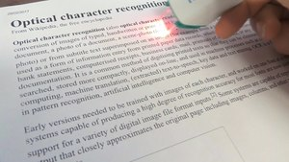
10. OPTICAL CHARACTER READER (OCR)
Optical character recognition or optical character reader (ocr) is the electronic or mechanical conversion of images of typed, handwritten or printed text into machine-encoded text, whether from a scanned document, a photo of a document, a scene-photo (for example the text on signs and billboards in a landscape photo) or from subtitle text superimposed on an image (for example: from a television broadcast).
video of the process of scanning and real-time optical character recognition (ocr) with a portable scanner.
Widely used as a form of data entry from printed paper data records – whether passport documents, invoices, bank statements, computerized receipts, business cards, mail, printouts of static-data, or any suitable documentation .

Slide 55
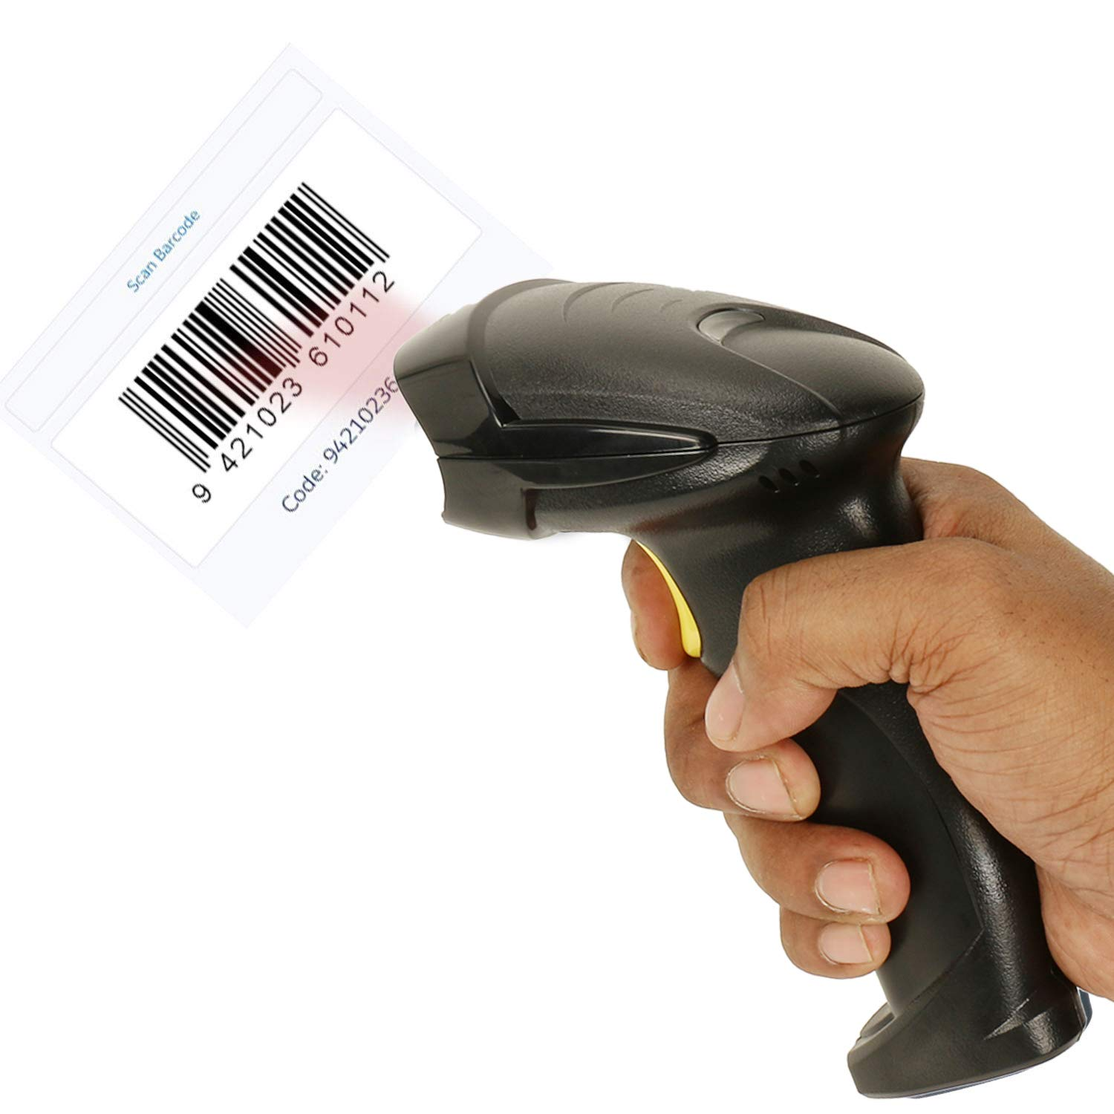
11. BARCODE READER
A barcode reader (or barcode scanner) is an optical scanner that can read printed barcodes, decode the data contained in the barcode and send the data to a computer.
Like a flatbed scanner, it consists of a light source, a lens and a light sensor translating for optical impulses into electrical signals.
Additionally, nearly all barcode readers contain decoder circuitry that can analyze the barcode's image data provided by the sensor and sending the barcode's content to the scanner's output port.

Slide 56
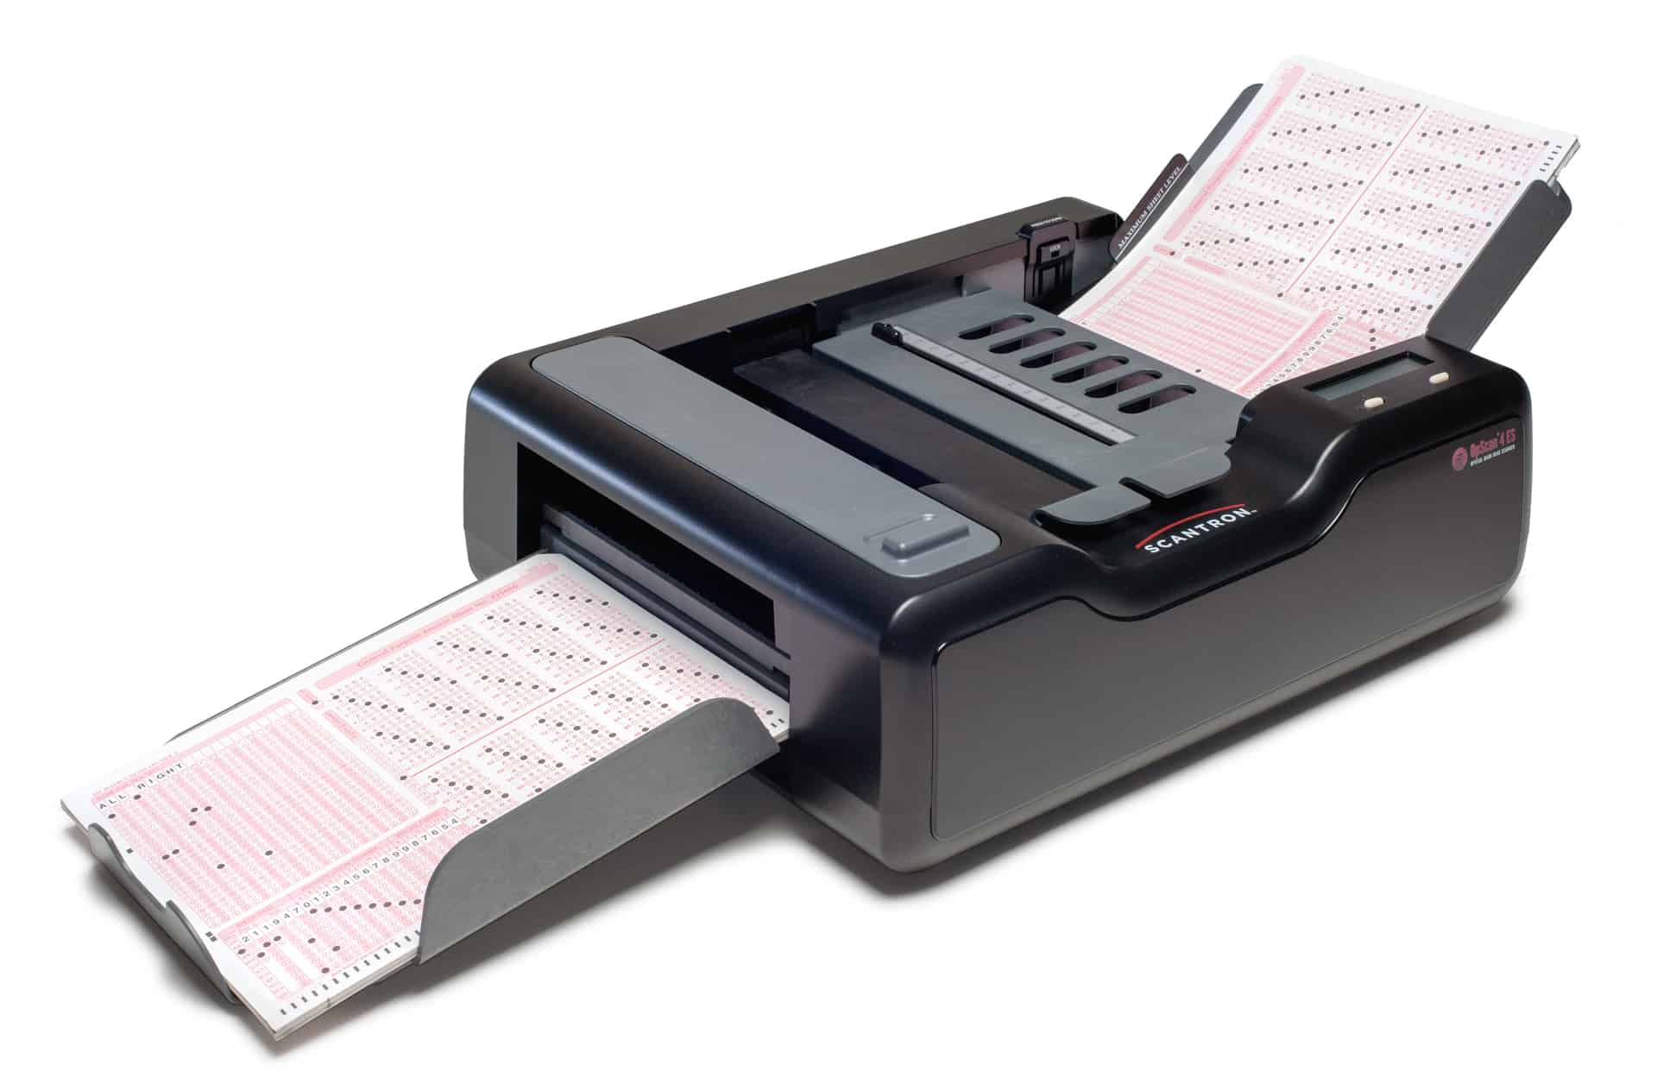
12. OPTICAL MARK READER (OMR)
Optical mark recognition (also called optical mark reading and omr) is the process of capturing human-marked data from document forms such as surveys and tests.
They are used to read questionnaires, multiple choice examination paper in the form of lines or shaded areas.
Optical mark recognition (also called optical mark reading and omr) is the process of capturing human-marked data from document forms such as surveys and tests.
They are used to read questionnaires, multiple choice examination paper in the form of lines or shaded areas.

Slide 57
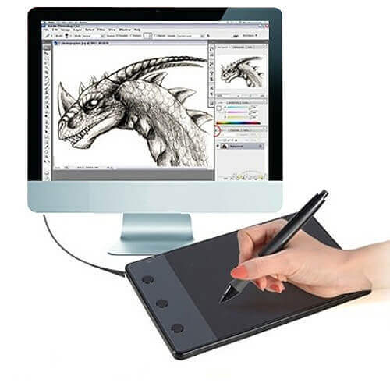
13. DIGITIZER
Digitizer is a computer input device that has a flat surface and usually comes with a stylus. it enables the user to draw images and graphics using the stylus as we draw on paper with a pencil.
The images or graphics drawn on the digitizer appear on the computer monitor or display screen. the software converts the touch inputs into lines and can also convert handwritten text to typewritten words.
It can be used to capture handwritten signatures and data or images from taped papers.
Furthermore, it is also used to receive information in the form of drawings and send output to a cad (computer-aided design) application and software like autocad.

Slide 58
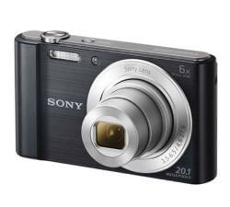
14. DIGITAL CAMERA
It is a digital device as it captures images and records videos digitally and then stores them on a memory card.
It is provided with an image sensor chip to capture images, as opposed to film used by traditional cameras.
Besides this, a camera that is connected to your computer can also be called a digital camera.
It has photosensors to record light that enters the camera through the lens.
When the light strikes the photosensors, each of the sensors returns the electrical current, which is used to create the images.

Slide 59

15. PADDLE
It is a simple input device that is widely used in games.
It is a wheel that is held by hand and looks like a volume knob on a stereo that is used to increase or decrease the volume.
Paddle moves or controls cursor or any other objects in the game in a back-and-forth motion.
It is widely used as an alternative to the joystick. besides this, the term paddle also refers to many handheld devices designed to control a function in an electronic device, computer, etc.

Slide 60

16. STEERING WHEEL
It is used as an input device in racing video games such as car racing games or in driving programs as virtual simulators to steer a vehicle.
It works like the real steering wheel by allowing you to take a right or left turn.
A steering wheel may be provided with acceleration and brake pedal devices and a mechanism for shifting gears.
Thus, it makes racing games more adventurous and entertaining.

Slide 61

17. GESTURE RECOGNITION DEVICES
These devices take human gestures as input. there are many such devices that respond to gestures.
For example, kinect is one such device that observes the movement of a player's body and interprets these movements as inputs to video games.
This feature is also available in certain tablets and smartphones where you can perform certain tasks such as taking pictures using finger gestures such as swiping, pinching, etc.

Slide 62

18. LIGHT GUN
As the name suggests, it is a pointing input device that is designed to point at and shoot the targets on the screen in a video game, or arcade, etc.
The light gun was used for the first time on the mit whirwind computer. when the gun is pointed at the target on the screen and the trigger is pulled, the screen goes blank for a fraction of a second.
During this moment, the photodiode, which is present in the barrel, determines where the gun is pointed. for example, shooting ducks in a duck hunt game.

Slide 63

19. TOUCHPAD
It is usually found in laptops as a substitute for the mouse.
It allows you to move or control the cursor on the screen using your finger.
Just like a mouse, it also has two buttons for right and left click. Using the touchpad, you can perform all the tasks that you do with a mouse, such as selecting an object on the screen, copy, paste, delete, open a file or folder, and more.

Slide 64

20. REMOTE
It is a hardware device designed to control the functioning of a device, e.g., a tv remote that can be used to change channels, increase or decrease the volume, from a distance without leaving the seat.
The first cordless tv remote was invented by dr. robert adler of zenith in 1956.
The remote sends the electromagnetic waves to communicate with the device. these waves can be infrared rays, radio waves, etc.

Slide 65

21. TOUCH SCREEN
It is the display screen of a device such as a smartphone, tablet, etc., that allows users to interact or provide inputs to the device by using their finger.
Today, most of the electronic devices come with touchscreen as an alternative to a mouse for navigating a graphical user interface.
For example, by touching, you can unlock your phone, open emails, open files, play videos, etc.
Besides this, it is used in lots of devices such as camera, car gps, fitness machine, etc.

Slide 66

22. VR
Vr stands for virtual reality. it is an artificial or virtual environment which is generated by computers.
A person can interact with virtual objects of this artificial environment using some input devices such as headsets, gloves, headphones, etc.
For example, he or she can find himself or herself walking on a beach, watching a football match, walking in the sky, etc., without actually doing all this.

Slide 67

23. WEBCAM
Any camera which is connected to a computer is called a webcam.
The in-built camera provided on a computer can also be considered a webcam.
It is an input device as it can take pictures, and can be used to record videos if required.
The pictures and videos are stored in the computer memory and can be displayed on the screen if required.
Although it works almost the same as the digital camera, it is different from a digital camera, as it is designed to take compact digital photos that can be uploaded easily on the webpages and shared with others through the internet.

Slide 68

24. BIOMETRIC DEVICES
Biometrics refers to a process in which a person is identified through his or her biological features such as fingerprints, eye cornea, face structure, etc.
It is done by using biometric devices, which can be of different types based on their scanning features and abilities .

Slide 69

2. CPU
Cpu stands for "central processing unit." the cpu is the primary component of a computer that processes instructions. It runs the operating system and applications, constantly receiving input from the user or active software programs. it processes the data and produces output, which may stored by an application or displayed on the screen.
The cpu contains at least one processor, which is the actual chip inside the cpu that performs calculations. for many years, most cpus only had one processor, but now it is common for a single cpu to have at least two processors or "processing cores." a cpu with two processing cores is called a dual-core cpu and models with four cores are called quad-core cpus. high-end cpus may have six (hexa-core) or even eight (octo-core) processors. a computer may also have more than one cpu, which each have multiple cores. for example, a server with two hexa-core cpus has a total of 12 processors.
While processor architectures differ between models, each processor within a cpu typically has its own alu, fpu, register, and l1 cache. in some cases, individual processing cores may have their own l2 cache, though they can also share the same l2 cache. a single frontside bus routes data between the cpu and the system memory.

Slide 70
tYpes of processors
There are five types of general-purpose processors they are, microcontroller, microprocessor, embedded processor, dsp and media processor.
Microprocessor: The general-purpose processors are represented by the microprocessor in embedded systems. there are different varieties of microprocessors available in the market from different companies. the microprocessor is also a general-purpose processor that consists of a control unit, Alu, a bunch of registers also called scratchpad registers, control registers and status registers.
Microcontroller: The microcontroller is basically a computer that comes in various packages and sizes. the reading input and responding to output is the basic function of the microcontroller. generally, it is known as general purpose input output (gpio). some of the microcontrollers are microchip atmega328-au, microchip p1c16f877a-i/p, microchip p1c16f1503-i/p, microchip p1c16f671-i/sn, microchip p1c18f45k22-i/p, etc.
Embedded processor: An embedded processor is one type of processor which is designed to control mechanical functions and electrical functions. it consists of several blocks they are the processor, timer, an interrupt controller, program memory and data memory, power supply, reset and clock oscillator circuits, system application-specific circuits, ports and interfacing circuits.
Digital signal processor: The digital signal processor is one type of processor used for measuring, filtering and/or compress digital or analog signals. the signal processing means analysis and manipulation of signal. this processing can be done via computer or application specific integrated circuits (asic), field programmable gate array (fpga) or digital signal processor (dsp) to obtain the clear signal. the dsp processors are used in an oscilloscope, barcode scanners, mobile phones, printers, etc.
Media processor: The image/video processor is the media processor that is designed or created to deal with the data in real-time. the voice user interface and professional audio are the applications of the audio processor. some of the media processors are tn2302ap ip, in2602 ap ip, dm3730, dm3725, dm37385, dm388, tms320dm6467, tms320dm6431, etc

Slide 71
Different types of pentium processors
PENTIUM.
PENTIUM PRO.
PENTIUM II.
PENTIUM III.
PENTIUM 4.
PENTIUM D.
PENTIUM M.
PENTIUM DUAL-CORE.

Slide 72
FEATURES OF PROCESSOR
64 bit data bus.
8 bytes of data information can be transferred to and from memory in a single bus cycle.
Supports burst read and burst write back cycles.
Supports pipelining.
Instruction cache.
8 kb of dedicated instruction cache.

Slide 73

Pentium processors
Pentium, family of microprocessors developed by intel corp. introduced in 1993 as the successor to intel’s 80486 microprocessor, the pentium contained two processors on a single chip and about 3.3 million transistors. using a cisc (complex instruction set computer) architecture, its main features were a 32-bit address bus, a 64-bit data bus, built-in floating-point and memory-management units, and two 8kb caches.
It was available with processor speeds ranging from 60 megahertz (mhz) to 200 mhz.
The pentium quickly became the processor of choice for personal computers. it was superseded by ever faster and more powerful processors, the pentium pro (1995), the pentium ii (1997), the pentium iii (1999), and the pentium 4 (2000).

Slide 74

PENTIUM PRO
Intel’s Pentium Pro, which was launched at the end of 1995 with a CPU core consisting of 5.5 million transistors and 15.5 million transistors in the Level 2 cache, was initially aimed at the server and high-end workstation markets.
It is a superscalar processor incorporating high-order processor features and is optimised for 32-bit operation. The Pentium Pro was also the first Intel microprocessor for some years not to use the venerable Socket 7 form factor, requiring the larger 242-pin Socket 8 interface and a new motherboard design.
The Pentium Pro differs from the Pentium in having an on-chip Level 2 cache of between 256KB and 1MB operating at the internal clock speed. The siting of the secondary cache on the chip, rather than on the motherboard, enables signals to get between the two on a 64-bit data path, rather than the 32-bit path of Pentium system buses. Their physical proximity also adds to the performance gain. The combination is so powerful that Intel claims 256KB of cache on the chip is equivalent to over 2MB of motherboard cache.

Slide 75

Pentium II
Pentium® II Processor at 350 MHz, 400 MHz, and 450 MHz
Product Features
Available at 350 MHz, 400 MHz, and 450 MHz frequencies
System bus frequency at 100 MHz
• Binary compatible with applications running on previous members of the Intel microprocessor line
• Dynamic execution micro architecture
• Dual Independent Bus architecture: Separate dedicated external System Bus and dedicated internal high-speed cache bus • Power Management capabilities —System Management mode —Multiple low-power states
The Intel Pentium® II processor is designed for high-performance desktops and for workstations and servers.
It is binary compatible with previous Intel Architecture processors.
The Pentium II processor provides the best performance available for applications running on advanced operating systems such as Windows* 95, Windows NT and UNIX*.
This is achieved by integrating the best attributes of Intel processors—the dynamic execution, Dual Independent Bus architecture plus Intel MMX™ technology—bringing a new level of performance for systems buyers.

Slide 76

Pentium III
The Pentium III is a microprocessor designed by Intel as a successor to its Pentium II. The Pentium III is faster, especially for applications written to take advantage of its "Katmai New Instructions" (the code name for the Pentium III during development was "Katmai").
The 70 new computer instructions make it possible to run 3-D, imaging, streaming video, speech recognition, and audio applications more quickly . In addition, the Pentium III offers clock speeds up to 800 MHz.
Katmai New Instructions are similar to the instructions optimized for multimedia applicaPentiums.tions called MMX and now included in most.
However, unlike the MMX instruction set, the Katmai instructions support floating point units as well as integer calculations, a type of calculation often required when still or video images are modified for display. The Katmai instructions also support Single Instruction Multiple Data instructions. These allow a single instruction to cause data to be modified in multiple memory locations simultaneously, a kind of parallel processing.

Slide 77

Pentium 4
Pentium 4 is a series of single-core CPUs for desktops, laptops and entry-level servers manufactured by Intel.
The processors were shipped from November 20, 2000 until August 8, 2008. The production of Netburst processors was active from 2000 until May 21, 2010.
All Pentium 4 CPUs are based on the NetBurst microarchitecture. The Pentium 4 Willamette (180 nm) introduced SSE2, while the Prescott (90 nm) introduced SSE3. Later versions introduced Hyper-Threading Technology (HTT).
The first Pentium 4-branded processor to implement 64-bit was the Prescott (90 nm) (February 2004), but this feature was not enabled. Intel subsequently began selling 64-bit Pentium 4s using the "E0" revision of the Prescotts, being sold on the OEM market as the Pentium 4, model F.
The E0 revision also adds eXecute Disable (XD) (Intel's name for the NX bit) to Intel 64. Intel's official launch of Intel 64 (under the name EM64T at that time) in mainstream desktop processors was the N0 stepping Prescott-2M.

Slide 78

Pentium d
The Pentium D brand refers to two series of desktop dual-core 64-bit x86-64 microprocessors with the NetBurst microarchitecture, which is the dual-core variant of Pentium 4 "Prescott" manufactured by Intel.
Each CPU comprised two dies, each containing a single core, residing next to each other on a multi-chip module package.
The brand's first processor, codenamed Smithfield, was released by Intel on May 25, 2005.
Nine months later, Intel introduced its successor, codenamed Presler,but without offering significant upgrades in design, still resulting in relatively high power consumption

Slide 79

Pentium m
The Pentium M is a family of mobile 32-bit single-core x86 microprocessors (with the modified Intel P6 microarchitecture) introduced in March 2003 and forming a part of the Intel Carmel notebook platform under the then new Centrino brand.
The Pentium M processors had a maximum thermal design power (TDP) of 5–27 W depending on the model, and were intended for use in laptops (thus the "M" suffix standing for mobile).
They evolved from the core of the last Pentium III–branded CPU by adding the front-side bus (FSB) interface of Pentium 4, an improved instruction decoding and issuing front end, improved branch prediction, SSE2 support, and a much larger cache.
The first Pentium M–branded CPU, code-named Banias, was followed by Dothan.^{[3]} The Pentium M-branded processors were succeeded by the Core-branded dual-core mobile Yonah CPU with a modified microarchitecture.

Slide 80

Pentium dual core
The Pentium Dual-Core brand was used for mainstream x86-architecture microprocessors from Intel from 2006 to 2009 when it was renamed to Pentium.
The processors are based on either the 32-bit Yonah or (with quite different microarchitectures) 64-bit Merom-2M, Allendale, and Wolfdale-3M core, targeted at mobile or desktop computers.
In terms of features, price and performance at a given clock frequency, Pentium Dual-Core processors were positioned above Celeron but below Core and Core 2 microprocessors in Intel's product range.
The Pentium Dual-Core was also a very popular choice for overclocking, as it can deliver high performance (when overclocked) at a low price.

Slide 81

Core processor
Intel Core are streamlined midrange consumer, workstation and enthusiast computers central processing units (CPU) marketed by Intel Corporation.
These processors displaced the existing mid- to high-end Pentium processors at the time of their introduction, moving the Pentium to the entry level
Identical or more capable versions of Core processors are also sold as Xeon processors for the server and workstation markets.
As of June 2017, the lineup of Core processors includes the Intel Core i3, Intel Core i5, Intel Core i7, and Intel Core i9, along with the X-series of Intel Core CPUs.

Slide 82


Slide 83


Slide 84



Slide 85

core i3
Developed and manufactured by Intel, and first introduced and released in 2010, the Core i3 is a dual-core computer processor, available for use in both desktop and laptop computers. It is one of three types of processors in the "i" series (also called the Intel Core family of processors).
The Core i3 processor is available in multiple speeds, ranging from 1.30 GHz up to 3.50 GHz, and features either 3 MB or 4 MB of cache. It utilizes either the LGA 1150 or LGA 1155 socket on a motherboard.
Core i3 processors are most often found as dual-core, having two cores. However, a select few high-end Core i3 processors are quad-core, featuring four cores.
The most common type of RAM used with a Core i3 processor is DDR3 1333 or DDR3 1600.
Power usage varies for the Core i3 processors:
Slower speeds (1.30 GHz to 1.80 GHz) use 11.5 W, 15 W or 25 W of power
Medium speeds (2.00 GHz to 2.50 GHz) use 28 W, 35 W or 37 W of power
Faster speeds (2.90 GHz to 3.50 GHz) use 35 W, 37 W or 54 W of power
Core i3 processors are often used in laptop computers, due to their lower heat generation and conservative battery usage. Some laptops can be used for up to five or six hours on a single battery charge when running a Core i3 processor.

Slide 86

Core i5
Developed and manufactured by Intel, the Core i5 is a computer processor, available as dual-core or quad-core. It can be used in both desktop and laptop computers, and is one of four types of processors in the "i" (Intel Core family) series.
The first i5 processor was released in September 2009 and new generations of the i5 continue to be released (2020).
The Core i5 processor is available in multiple speeds, ranging from 1.90 GHz up to 3.80 GHz, and it features 3 MB, 4 MB or 6 MB of cache. It utilizes either the LGA 1150 or LGA 1155 socket on a motherboard. Core i5 processors are most often found as quad-core, having four cores. However, a select few high-end Core i5 processors feature six cores.
The most common type of RAM used with a Core i5 processor is DDR3 1333 or DDR3 1600. However, higher performance RAM can be used as well if it's supported by the motherboard.
Power usage varies for the Core i5 processors:
Slower speeds (1.90 GHz to 2.30 GHz) use 11.5 W of power
Medium speeds (2.60 GHz to 3.10 GHz) use 15 W, 25 W, 28 W or 37 W of power
Faster speeds (3.20 GHz to 3.80 GHz) use 35 W, 37 W, 45 W, 47 W, 65 W or 84 W of power
Core i5 processors are commonly found in desktop computers for most everyday use and some higher performance needs.
Some laptop computers feature Core i5 processors as well, to provide improved performance for heavier usage needs. At the lower speeds, battery usage is pretty conservative and can reach up to five hours or usage on a single charge. However, at higher speeds, battery usage is higher and may result in up to three hours or so of usage per charge.

Slide 87


core i7

Slide 88

Core i9
Intel Core i9 is a line of Intel CPUs introduced in May 2017. Core i9 CPUs feature as few as six and as many as eighteen cores, with two threads per core when hyperthreading is enabled.
Its frequencies range from 2.9 to 3.6 GHz, and up to 5.0 GHz when using Intel Turbo Boost.
All Core i9 CPUs interface with a new Intel socket type, LGA 2066. Therefore, they are not compatible with previous-generation motherboards.

Slide 89



Slide 90

Amd – ryzen and athlon
What is amd?
Advanced Micro Devices, Inc. (AMD) is an American multinational semiconductor company based in Santa Clara, California, that develops computer processors and related technologies for business and consumer markets.
While it initially manufactured its own processors, the company later outsourced its manufacturing, a practice known as going fabless, after GlobalFoundries was spun off in 2009.
AMD's main products include microprocessors, motherboard chipsets, embedded processors and graphics processors for servers, workstations, personal computers and embedded system applications.

Slide 91
What is ryzen?
Ryzen is a brand of x86-64 microprocessors designed and marketed by Advanced Micro Devices (AMD) for desktop, mobile, server, and embedded platforms based on the Zen microarchitecture.
It consists of central processing units (CPUs) marketed for mainstream, enthusiast, server, and workstation segments and accelerated processing units (APUs) marketed for mainstream and entry-level segments and embedded systems applications.
AMD officially announced a new series of processors, named "Ryzen", during its New Horizon summit on December 13, 2016 and introduced Ryzen 1000 series processors in February 2017, featuring up to 8 cores and 16 threads, which launched on March 2, 2017.

Slide 92
Different amd ryzen processor
Ryzen 3 -Up to 4-core processors.
Ryzen 5 -Up to 6-core processors.
Ryzen 7 -Up to 8-core processors.
Ryzen 9 -Up to 16-core processors.
Threadripper -Up to 64-core processors.

Slide 93

Ryzen 3
Ryzen 3 processors feature a mix of dual-core and quad-core processors. However, multi-threading on the dual-core processors, so the operating system always sees 4 cores no matter which Ryzen 3 processor is present in your laptop.
Depending on which Ryzen 3 processor your laptop has, it will have either Vega 3 or Vega 6 Integrated Graphics.
All the Ryzen 3 processors are ‘U’ series processors which means you will find them in ultra-thin laptops which have high battery life and are perfect for folks on the move.
Ideal for: Multitasking, streaming 4K movies, gaming and more.
Laptops featuring Ryzen 3 Mobile processor:
HP 14-dk0001ns, HP 15-db1002ng, HP 15-db1013ns

Slide 94

Ryzen 5
Ryzen 5 (pronounced Rye-Zen Five) is a family of mid-range performance 64-bit quad and hexa-cores x86 microprocessors introduced by AMD in March of 2017.
Ryzen 5 is based on the Zen microarchitecture and is manufactured on GF's 14 nm process. Ryzen 5 is marketed toward the mid-range performance market.
The Ryzen 5 is positioned against Intel's mid-range mainstream Core i5 processors, offering competitive performance at lower prices.
Introduced in April 2017, the Ryzen 5 family is aimed at mid-range performance desktop and sport either 4 or 6 cores.
The Ryzen 5 is situated under the Ryzen 7 family, offering all of the features but fewer cores.

Slide 95

Ryzen 7
Ryzen 7 (pronounced Rye-Zen Seven) is a family of high-performance 64-bit octa-core x86 microprocessors introduced by AMD in 2017 as a successor to the FX family.
Ryzen 7 is based on the Zen microarchitecture and is manufactured on GF's 14 nm process.
Ryzen 7 is marketed toward the high-end enthusiasts desktop market offering the highest level of performance.
The Ryzen 7 is positioned against Intel's high-end Core i7 processors, offering competitive performance at lower prices.
Introduced by AMD in February of 2017, the Ryzen 7 is the first family of performance processors based on the Zen microarchitecture, a successor to Excavator.

Slide 96

Ryzen 9
Ryzen 9 is a family of high-performance 64-bit dodeca-core x86 and hexadec microprocessors introduced by AMD in 2019.
Ryzen 9 is based on the Zen 2 microarchitecture and is manufactured on TSMC's 7 nm process.
Ryzen 9 is marketed toward the high-end enthusiasts desktop market offering the highest level of performance.
The Ryzen 9 is positioned against Intel's high-end Core i9 processors, offering competitive and greater performance at lower or similar prices.

Slide 97

Ryzen – threadripper
Ryzen Threadripper is a family of 64-bit x86 enthusiasts/high-performance desktop microprocessors.
Ryzen Threadripper is geared toward prosumers that rely on heavily threaded applications and multitasking.
Ryzen Threadripper is a family of high core count x86 microprocessors.
Threadripper is geared toward mainstream users who rely on heavily threaded applications and multitasking beyond what the Ryzen 7 processors can provide.
While Threadripper uses the same dies as the ones used for Ryzen, their performance characteristics are a little different. Since every die has a slightly different performance characteristics, even from within the same wafer, AMD sorts those dies based on this performance. The top 5% Ryzen dies are then used for the Threadripper models. Higher-performance dies allow for higher efficiency in terms of power consumption at higher clock speeds and in theory allow for higher overclocking overhead.

Slide 98




Amd – athlon
Athlon is the brand name applied to a series of x86-compatible microprocessors designed and manufactured by Advanced Micro Devices (AMD).
The original Athlon (now called Athlon Classic) was the first seventh-generation x86 processor and was the first desktop processor to reach speeds of one gigahertz (GHz).
It made its debut as AMD's high-end processor brand on June 23, 1999.
Over the years AMD has used the Athlon name with the 64-bit Athlon 64 architecture, the Athlon II, and Accelerated Processing Unit (APU) chips targeting the Socket AM1 desktop SoC architecture, and Socket AM4 Zen microarchitecture.
The modern Zen-based Athlon with a Radeon Graphics processor was introduced in 2019 as AMD's highest-performance entry-level processor.[
Athlon name originally used for AMD's mid-range processors with combined CPU/GPU processors with the GPU disabled, AMD currently uses Athlon for budget APUs with integrated graphics. AMD positions the Athlon against its rival, the Intel Pentium.

Slide 99
Different types of athlon
Athlon 550
Athlon 600
Athlon 650
Athlon 700

Slide 100


Athlon 550

Slide 101


Athlon 600

Slide 102


Athlon 650

Slide 103

Athlon 700
The AMD Athlon 700 was a desktop processor with 1 core, launched in June 2000.
It is part of the Athlon Model 4 lineup, using the Thunderbird architecture with Socket A.
Athlon 700 has 256K of L2 cache and operates at 700 MHz. .
. This processor does not have integrated graphics, you will need a separate graphics card.

Slide 104
Computer memory
Computer memory is any physical device capable of storing information temporarily or permanently. There are two types of computer memory Primary Memory or Main Memory whicn include RAM (Random Access Memory) & ROM (Read Only Memory) and Secondary Memory or Auxiliary Memory which include Magnetic Disk, Magnetic Tape, Optical Disk etc.
Primary Memory
Random Access Memory (RAM) - is a type of volatile memory that is stores information on an integrated circuit which hold the data mainly when the program is being executed by the CPU. As it is volatile in nature so it can't store data permanently.
Read Only Memory (ROM) - a non-volatile memory chip in which data are stored permanently, and can not be altered by the programmer.
Secondary Memory
A storage, which suppliments the main memory of a computer. Often refferred to as secondary storage, this section of computer's memory is non-volatile and has low cost per bit stored, but it generally has an operating speed far slower than that of the primary storage.
Cache Memory
A small high speed memory, which is used to increase the speed of processing by making current programs and data available to the CPU at a rapid rate.

Slide 105


Slide 106

Primary memory
Primary memory is also known as main memory or may also refer to “Internal memory.” and primary storage
All those types of computer memories that are directly accessed by the processor using data bus are called primary memory.
That allows a processor to access stores running programs and currently processed data that stored in a memory location.
The use of memories is therefore mandatory in all systems using a microprocessor, including computers.
An example of Primary memory is RAM and ROM that store programs.
These memories are limited in capacity and manufactured by using integrated circuits (IC) or semiconductor device. Its speed of Data accessing is faster than secondary memory. It is more expensive than secondary memory.
When you turn on the computer, Generally CPU searches for essential codes in RAM to get it. Otherwise, it goes to ROM. Yes, they both chips collectively called primary memory in a computer system.

Slide 107

Random access memory(ram)
Random Access Memory (RAM) is used to store the programs and data being used by the CPU in real-time. The data on the random access memory can be read, written, and erased any number of times. RAM is a hardware element where the data being currently used is stored. It is a volatile memory. Types of RAM:
Static RAM, or (SRAM) which stores a bit of data using the state of a six transistor memory cell.
Dynamic RAM, or (DRAM) which stores a bit data using a pair of transistor and capacitor which constitute a DRAM memory cell.

Slide 108
DDR4 RAM
Stands for "Double Data Rate 4."
DDR4 is the fourth generation of DDR RAM, a type of memory commonly used in desktop and laptop computers.
It was introduced in 2014, though it did not gain widespread adoption until 2016.
DDR4 is designed to replace DDR3, the previous DDR standard.
Advantages include faster data transfer rates and larger capacities, thanks to greater memory density and more memory banks (16 rather than 8).
DDR4 also operates at a lower voltage (1.2V compared to 1.5V), so it is more power-efficient.

Slide 109

DDR4 specifications:
64 GB maximum capacity per memory module (common capacities include 16 GB and 32 GB)
16 internal memory banks
1600 Mbps to 3200 Mbps data transfer rates
1.2 volts of electrical power required
288 pins in a regular DIMM, 260 pins in a SO-DIMM

Slide 110

DDR4 memory modules come in two primary form factors — DIMMs and SO-DIMMs.
DIMMs are commonly generally used for desktop towers, while smaller SO-DIMMs are designed for laptops and all-in-one desktop computers.
DDR4 DIMMs are the first to have a curved bottom edge, which makes it easier to insert them into and remove them from RAM slots on a motherboard. This and the unique position of the notch between the pins make it impossible to insert a DDR4 chip into an incompatible slot.

Slide 111
HARD DISK DRIVES
A hard disk drive (sometimes abbreviated as a hard drive, HD, or HDD) is a non-volatile data storage device.
It is usually installed internally in a computer, attached directly to the disk controller of the computer's motherboard.
It contains one or more platters, housed inside of an air-sealed casing. Data is written to the platters using a magnetic head, which moves rapidly over them as they spin.
In 2018, the largest hard drive had a capacity of 15 TB.As of 2018, HDDs were forecast to reach 100 TB capacities around 2025, but as of 2019 the expected pace of improvement was pared back to 50 TB by 2026.

Slide 112



Slide 113
Solid State Drives (SSD)
A solid-state drive (SSD) is a new generation of storage device used in computers.
SSDs replace traditional mechanical hard disks by using flash-based memory, which is significantly faster. Older hard-disk storage technologies run slower, which often makes your computer run slower than it should.
SSDs speed up computers significantly due to their low read-access times and fast throughputs.
SSDs are available in all sorts of storage capacity, starting at around 32 GB and ranging up to 5 TB in the consumer space.

Slide 114



Slide 115

EXPANSION BUSES
INDUSTRY STANDARD ARCHITECTURE (ISA)
"Industry Standard Architecture." ISA is a type of bus used in PCs for adding expansion cards.
An ISA slot may be used to add a video card, a network card, or an extra serial port. The original 8-bit version of PCI uses a 62 pin connection and supports clock speeds of 8 and 33 MHz.

Slide 116
ACCELERATED GRAPHICS PORT(AGP)
Short for accelerated graphics port, AGP is an advanced port designed for video cards and 3D accelerators.
Developed by Intel and introduced in August 1997, AGP introduces a dedicated point-to-point channel that allows the graphics controller direct access to the system memory.
The AGP channel is 32-bits wide and runs at 66 MHz, which is a total bandwidth of 266 MBps and much greater than the PCI bandwidth (up to 133 MBps).
AGP also supports two optional faster modes, with a throughput of 533 MBps and 1.07 GBps.

Slide 117

It also allows 3-D textures to be stored in main memory rather than video memory.
AGP is available in three different versions, the original AGP version mentioned above, AGP 2.0 that was introduced in May 1998, and AGP 3.0 (AGP 8x) that was introduced in November 2000. AGP 2.0 added 4x signaling and was capable of operating at 1.5V, and AGP 3.0 was capable of double the transfer speeds.

Slide 118
PERIPHERAL COMPONENT INTERCONNECT(PCI)
peripheral component interconnect, PCI was introduced by Intel in 1992.
The PCI bus came in both 32-bit (speed of 133 MBps) and 64-bit versions and was used to attach hardware to a computer.
Although commonly used in computers from the late 1990s to the early 2000s, PCI has since been replaced with PCI Express.
Revisions came in 1993 to version 2.0, and in 1995 to PCI 2.1, as an expansion to the ISA bus.
Unlike ISA and other earlier expansion cards, PCI follows the PnP specification and therefore did not require any jumpers or dip switches.

Slide 119

Width in bits: 32 or 64
Year created: June 22, 1992; 28 years ago
Created by: Intel
Style: Parallel

Slide 120

PCI EXPRESS(PCI-X)
PCI-X, short for Peripheral Component Interconnect eXtended, is a computer bus and expansion card standard that enhances the 32-bit PCI local bus for higher bandwidth demanded mostly by servers and workstations.
Width in bits: 64
Speed: Half-duplex 266–4266 MB/s
Superseded by: PCI Express (2004)

Slide 121

Read only memory(rom)
Read Only Memory (ROM) is a type of memory where the data has been prerecorded. Data stored in ROM is retained even after the computer is turned off ie, non-volatile. Types of ROM:
Programmable ROM, where the data is written after the memory chip has been created. It is non-volatile.
Erasable Programmable ROM, where the data on this non-volatile memory chip can be erased by exposing it to high-intensity UV light.
Electrically Erasable Programmable ROM, where the data on this non-volatile memory chip can be electrically erased using field electron emission.
Mask ROM, in which the data is written during the manufacturing of the memory chip.

Slide 122

Difference between ram and rom

Slide 123

Secondary memory
Secondary memory refers to storage devices, such as hard drives and solid state drives. It may also refer to removable storage media, such as USB flash drives, CDs, and DVDs.
Unlike primary memory, secondary memory is not accessed directly by the CPU. Instead, data accessed from secondary memory is first loaded into RAM and is then sent to the processor.
The RAM plays an important intermediate role, since it provides much faster data access speeds than secondary memory. By loading software programs and files into primary memory, computers can process data much more quickly.
While secondary memory is much slower than primary memory, it is typically offers far greater storage capacity. For example, a computer may have a one terabyte hard drive, but only 16 gigabytes of RAM. That means the computer has roughly 64 times more secondary memory than primary memory. Additionally, secondary memory is non-volatile, meaning it retains its data with or without electrical power.
RAM, on the other hand, is erased when a computer is shut down or restarted. Therefore, secondary memory is used to store "permanent data," such as the operating system, applications, and user files.
NOTE: Secondary memory may also be called "secondary storage." However, this term is a bit more ambiguous, since internal storage devices are sometimes called "primary storage devices" as well.

Slide 124

Cache memory
Cache Memory is a special very high-speed memory. It is used to speed up and synchronizing with high-speed CPU.
Cache memory is costlier than main memory or disk memory but economical than CPU registers.
Cache memory is an extremely fast memory type that acts as a buffer between RAM and the CPU. It holds frequently requested data and instructions so that they are immediately available to the CPU when needed.
Cache memory is used to reduce the average time to access data from the Main memory.
The cache is a smaller and faster memory which stores copies of the data from frequently used main memory locations.
There are various different independent caches in a CPU, which store instructions and data.

Slide 125

Flash memory
Flash memory, also known as flash storage, is a type of nonvolatile memory that erases data in units called blocks and rewrites data at the byte level.
Flash memory is widely used for storage and data transfer in consumer devices, enterprise systems and industrial applications.
Flash memory retains data for an extended period of time, regardless of whether a flash-equipped device is powered on or off.
Flash memory is used in enterprise data center server, storage and networking technology, as well as in a wide range of consumer devices, including USB flash drives -- also known as memory sticks -- SD cards, mobile phones, digital cameras, tablet computers and PC cards in notebook computers and embedded controllers.
For instance, NAND flash-based solid-state drives are often used to accelerate the performance of I/O-intensive applications. NOR flash memory is often used to hold control code, such as the basic input/output system (BIOS), in a PC.

Slide 126

Output devices
An output device is any piece of computer hardware equipment which converts information into human readable form. It can be text, graphics, tactile, audio, and video.
Some of the output devices are Visual Display Units (VDU) i.e. a Monitor, Printer graphic Output devices, Plotters, Speakers etc. A new type of Output device is being developed these days, known as Speech synthesizer, a mechanism attached to the computer which produces verbal output sounding almost like human speeches.
Some examples of output devices are given below: I) Monitor II) Printer III) Speaker IV) Headphones V) Projector VI) GPS VII) Sound Card VIII) Video Card IX) OMR X) Braille reader

Slide 127

MONITOR
The computer monitor is a significant part, without it the user cannot function the computer. The screen of the monitor allows the user to interact with the computer. The monitor screen is for visual display of all types of information provided by the computer.
The main function of the monitor is obviously visual. As it acts as an interface between the CPU and the user. It doesn’t matter how powerful or fast your computer is, without a monitor display, the computer is incomplete or even useless.
The monitor is designed to display all kinds of information like image, video, symbolic, graphical, etc, as Soft Copy on its screen. A cable is connected with a video adapter that is set up with the computer’s motherboard to display the given data.

Slide 128
1.LIQUID CRYSTAL DISPLAY(LCD)
Liquid Crystal Display (LCD) monitors feature a layer of liquid held between two pieces of polarized glass.
The LCD monitor does not produce its own light. Instead, additional lighting behind the screen shines through the glass and illuminates the crystals.
LCD monitors are usually backlit by fluorescent lamps
Lifespan of 30,000 hours (eight years of use at 10 hours per day)
A lower price point due to being on the market for a longer period of time
Burn-in is not really an issue, making LCD monitors good for gamers since heads-up display (HUD) elements in some video games can lead to image retention

Slide 129

Top five advantages of LCD monitor are:
Energy Efficient
Long-Lasting
LED Backlighting
No Screen Burn-In
Supports Small and Low-Profile Sizes

Slide 130
2.LIQUID EMITTING DIODE(LED)
A LED display is a flat panel display that uses an array of light-emitting diodes as pixels for a video display. Their brightness allows them to be used outdoors where they are visible in the sun for store signs and billboards.
The basic advantage is the appearance of LEDs, which look too awesome. It provides the slim screen with sleek design which is adjustable at any place.
LEDs are far better than LCD monitors because they do not use fluorescent bulbs due to which they are lighter and thinner in weight. LEDs consume less energy and save a lot of power.
LEDs provide bright image quality by enhancing the contrast and enriching the range of colors. The wavelength range of lights used are such that to give high quality.

Slide 131

These LEDs monitor produces flicker free image which reduces eye fatigue, eye strains and headaches. They have a long lifespan in comparison to the LCD’s. The LCD’s use fluorescent bulbs due to which they consume a lot of power.
LEDs are environment-friendly and easy to use. Very efficient in giving response and also by controlling their brightness and color. Once you buy the LED then you save in terms of money and time for its maintenance.
LEDs don’t produce heat because they do not contain the fluorescent bulbs which can also cause damage by short-circuiting.

Slide 132
PHERIPHERAL DEVICE
A peripheral device is generally defined as any auxiliary device such as a computer mouse or keyboard, that connects to and works with the computer in some way.
Other examples of peripherals are expansion cards, graphics cards, image scanners, tape drives, microphones, loudspeakers, webcams, and digital cameras.

Slide 133

PRINTER
A printer is a device whose main function to print electronic information like text and images onto paper as a hard copy.
In this way, the process of transferring data to hard paper is called printing, and the result is a printout.
The printer prints the files like images, and text stored in a computer, by converting the data from soft copy to hard copy.
Printers are used to print signs, printing the online images, Excel sheets, PPT, and office documents at offices.
Normally the printer is equipped with a computer with a USB port, LAN, Ethernet, or simply a wireless connection.
At present, many printed devices featured with technologies like Wi-Fi, Cloud, and Bluetooth. Due to this, it becomes easier to complete the printing task by computer.

Slide 134
IMPACT PRINTER
The general features of impact printers are uses force by applying hammer pins to strike the paper
slow speed
prints on most paper types
transparencies not supported
multiple copies may be printed at once
Advantages : Less expensive, Fast (some types) , Can make multiple copies with multipart paper
Disadvantages : Noisy! Print quality lower in some types. Poor graphics or none at all

Slide 135

Dot matrix printers
The dot matrix printer have a head capable of firing tiny pins arranged in a matrix.
As the print head moves back and forth, these pins strike the ribbon causing dots to be made on the paper.
These same dots can be used to print text as well as graphicsSome dot matrix printer can also print in color.

Slide 136

Daisy wheel printers
Daisy wheel printers uses a wheel containing characters that rotates until the right character is facing the paper.
Although it prints high quality text, it cannot print graphics. Printing different types of font is also impractical since the wheel have to be changed in order to get a different font.

Slide 137
NON IMPACT PRINTER
General features print head does not make contact with the paper
higher speed in characters per second is possible
prints on most paper types but better quality obtained with better paper
transparencies usually supported
Uses ink spray or toner powder
Offer superior quality and greater options (in terms of the number of fonts and quality of graphic pictures)
Advantage : Produce high quality and high speed output Almost noiseless uses toner or ink cartridges, which are longer lasting

Slide 138
Disadvantages : more expensive.
The three main types of non-impact printers are laserjet, inkjet and thermal
Characters of printers
Speed: The speed of a printer is measured in: cps= characters per second, lpm= lines per minute ppm= pages per minute The faster the printing, the more expensive the printer.
Resolution: A more numerical measure of print quality is printer resolution. Measured in dots per inch (dpi), this determines how smooth a diagonal line the printer can produce.

Slide 139

Inkjet Printer
They squirt very small drops of ink on the paper in order to produce text and images.
They are commonly used in the home.
The are relatively cheap and produce high quality output at relatively high speed.

Slide 140

Laser Printer
A very fast printer that utilizes a laser beam along with a toner and a photoconductive rotating drum in order to produce very high quality output.
They are faster than inkjet printers
They are called page printers because it appears that they print an entire page at one time.
They are usually limited to office use because they are expensive.

Slide 141

Thermal Printers
They print by using heat.
Some thermal printers use special heat-sensitive paper.
Heat is applied to the paper to form text and graphics
They have low maintenance cost since there is not the need to buy toner or print ribbon.
Some fax machines print using this method.

Slide 142

SPEAKER
Computer speakers are a way that computers make sounds by means of digital or analog audio. I
n other terms, the speaker is also called ‘dynamic head’. This speaker can now be found on many other devices, like, on a TV, radio, smartphone, telephone, children’s toys, and others.
The main function of speakers as a way for computers to interact with their users. These provide a means for the computer to produce audio. The sound produced by computer speakers is done by a hardware component whose name is a sound card that pre-installed with the computer.
The speaker is important because for listening to the audios and sounds fo the videos and games which is significant for a computer user to perform all kinds of task on the computer.
However, in order to increase the sound of the computer in a louder way one may need external speakers. Alternatives to the speaker for computers are headphones, earphones, earbuds, etc.

Slide 143

HEADPHONES
Headphones are electronic audio devices that people wear over their ears.
They let people hear sounds on a walkman, MP3 player, mobile phone or computer.
Headphones come in many different sizes from big to small. They are also known as earphones, stereophones, headsets or even 'cans'. Earbuds are inserted into the ear
^{Headphones} typically uses small plug for connection. Some use a Bluetooth connection so they don't have the cord in the way
There is a risk of deafness if listening to headphones with a high volume for a long time.

Slide 144

PROJECTOR
A projector or image projector is an opticaldevice that projects an image (or moving images) onto a surface, commonly a projection screen.
Most projectors create an image by shining a light through a small transparent lens, but some newer types of projectors can project the image directly, by using lasers.
A virtual retinal display, or retinal projector, is a projector that projects an image directly on the retina instead of using an external projection screen.
The most common type of projector used today is called a video projector. Video projectors are digital replacements for earlier types of projectors such as slide projectorsand overhead projectors.

Slide 145

GPS
The Global Positioning System (GPS) is a satellite-based navigation system made up of at least 24 satellites.
GPS works in any weather conditions, anywhere in the world, 24 hours a day, with no subscription fees or setup charges.
The U.S. Department of Defense (USDOD) originally put the satellites into orbit for military use, but they were made available for civilian use in the 1980s.

Slide 146

SOUND CARD
Sound card process the signal from the motherboard and converts it to the audio. They help speakers and headphones to function. These components are not essential but they enhance the audio experience. If you listen to music, watch videos, play games, record audio, then you need a sound card.
Function
Process the electronic signal and help speakers to produce sound.
Types of Sound Card
On-Board Sound Cards
USB Sound Cards
PCMCIA / PC Cardbus

Slide 147

VIDEO CARD
The video card is the slot on the motherboard for enhancing the visuals of video and graphical contents. It enhances the experiences of watching movies, photos, playing games, etc. It increases the display quality of the monitor.
Every computer has a default video card. You can add an external video card that boosts up the visual elements. It gives faster and detailed visual content.

Slide 148

BRAILLE READER
A refreshable braille display or braille terminalis an electro-mechanical device for displaying characters, usually by means of round-tipped pins raised through holes in a flat surface.
Visually impaired computer users who cannot use a standard computer monitor can use it to read text output. Deafblind computer users may also use refreshable braille displays.
Speech synthesizers are also commonly used for the same task, and a blind user may switch between the two systems or use both at the same time depending on circumstances.

Slide 149

PLOTTER
A plotter is a computer hardware device much like a printer that is used for printing vector graphics.
Instead of toner, plotters use a pen, pencil, marker, or another writing tool to draw multiple, continuous lines onto paper rather than a series of dots like a traditional printer.
Though once widely used for computer-aided design, these devices have more or less been phased out by wide-format printers.
Plotters produce a hard copy of schematics and other similar applications

Slide 150

Introduction of Ports in Computers
A port is basically a physical docking point which is basically used to connect the external devices to the computer, or we can say that A port act as an interface between the computer and the external devices, e.g., we can connect hard drives, printers to the computer with the help of ports.

Slide 151
Features of computer ports
We can connect external devices to the computer with the help of ports and cables.
These are basically slots on motherboard where we connect external devices, or we can plug in external devices through cables.
Mouse, keyboards, printers, speakers are some examples of external devices that connected to the computer through ports.

Slide 152
Types of Ports:

Slide 153

Serial ports
1. Serial ports – A serial port is basically a serial communication interface through which information transforms one bit at a time. It is one of the oldest type of interfaces.
These are basically used for external modems.
These are basically available in two versions in market these are 9 pins, 25 pin models.
Data travels at a speed of 115 kilo-bits per second.

Slide 154

Parallel ports
2. Parallel ports – A parallel port is basically a parallel communication interface through which information transforms multiple bits at a time.
These are basically used to connect peripherals such as scanners or printers.
These are also known as printer ports.
These are available in a 25 pin model.
Data travels at a speed of 150 kilo bits per second.

Slide 155

PS/2 ports
3. PS/2 ports – These are basically 6 pin mini Din connector used to connect keyboard, mice to a PC compatible computers.
These are basically used by old computers for connecting mouse or keyboard.
These are called mouse ports.
These ports are still favoured in organisation for security reason.
These ports provides no restriction on key rollover

Slide 156

Universal serial bus port
4. Universal serial bus port – It is basically a standard cable connection interface between computer and external device. USB is an industrial standard for short-distance digital data communication.
Basically it can connect all types of external devices to the computer such as mouse, keyboard, printers, speakers etc.
These ports were introduced in 1997.
Minimum 2 ports are there in every computer system.
Data basically travels at a speed of 14mb/s which is much faster than serial port.
The devices that uses USB port gets power from a USB port.

Slide 157

Vga ports
5. VGA Ports – VGA connector stands for Video Graphic Array connector, these are basically 15 pin connector available in many video-cards, computer, projectors etc.
It is used to connect monitor to computer’s video card.
It is 15 pin connector.
These were introduced by IBM in 1987.
VGA basically utilizes analog signal hence it can only be used to lower resolution or we can say VGA is only capable of lowering the resolution.

Slide 158

Digital video interface(dvi)
It is another interface between a CPU and a monitor. It is a high-speed interface that is developed to transmit the lossless digital video signals and to replace analogue digital video signal transmission through VGA technology.
The DVI interface can be of three types based on the signals transmitted by it: DVI-I, DVI-D, and DVI-A. The DVI-I supports combined digital and analogue signals, whereas DVI-A supports only analogue signals, and DVI-D supports only digital signals.
Mini-DVI: As the name suggests, it is smaller than a commonly used DVI port. It is a 32 pin port developed by Apple as a substitute to Mini-VGA port. It can transmit various types of signals such as S-Video, VGA, and composite signals using respective adapters.

Slide 159

Display port
This interface allows transmitting a video and audio from a device to a display screen. It is an advanced display technology that is developed as a substitute for older interfaces such as DVI and VGA. A display port can be seen on laptops, desktops computers, tablets, monitors, etc. It has a 20-pin connector and offers a better resolution than DVI port.

Slide 160

Rca connector
It is designed to accept composite video and stereo signals transmitted by three cables called RCA cable.
A RAC cable has three color-coded plugs that are connected to the three corresponding coloured jacks of an RCA connector.
Eachof the coloured jack is ringed with metal. The red jack supports the right stereo channel, and the white one supports the left stereo channel, while the yellow is used for composite video.

Slide 161

Component video
This interface allows splitting video signals into three channels.
The component video generally has three color-coded slots; Red, Blue, and Green.
Each slot receives and then transmits a particular component of the video signal.
It offers high-quality videos than composite video and can carry both analogue and digital video signals.

Slide 162

Hdmi port
HDMI (High Definition Media Interface) is a digital interface developed to connect high definition devices such as digital cameras, gaming consoles, etc., to computers and TVs with HDMI ports.
Besides this, it can carry uncompressed video and uncompressed or compressed audio signals.
The advanced version of HDMI, such as 2.0, can transfer video signals of up to a resolution of 4096x2160.

Slide 163
Universal Serial Bus(USB)
A USB port is a standard cable connection interface for personal computers and consumer electronics devices.
USB stands for Universal Serial Bus, an industry standard for short-distance digital data communications. USB ports allow USB devices to be connected to each other with and transfer digital data over USB cables.
They can also supply electric power across the cable to devices that need it.
Both wired and wireless versions of the USB standard exist, although only the wired version involves USB ports and cables.

Slide 164

Port Types
USB-A (Type A): The rectangular USB Type-A connector approximately 1.4 cm (9/16 in) length by 0.65 cm (1/4 in) height is typically used for wired mice and keyboards. USB sticks normally feature USB-A connectors also.
USB-B (Type B): Less common than type A, USB B devices are nearly square in shape and are commonly found on routers, computers, printers, and game consoles
Micro USB: So-called Micro USB versions of both USB-A and USB-B also exist - smaller versions than their base counterparts, popular on mobile devices. Older but now obsolete "mini USB" versions can also be found on many old devices.
USB Type C: With dimensions of 0.84 cm by 0.26cm, this newer standard is designed to replace both A and B with smaller ports to better support the thinner form factors of mobile devices.

Slide 165
These are some of the common ports available in computer system. Except these there are many more ports available in computer. These are as follows:
Modem Port: These are basically used to connect PC’s modem to telephone networks.
Ethernet Port: These are basically used to connect Ethernet cables to the computer. In this data may travel with a speed of 10mb/s to 100 mb/s based on the network bandwidth.
Game Port: These ports are available in computer to connect joysticks which are now replaced by USB.
Digital Video Interface or we can say DVI Port these are basically used to connect flat panel LCD Monitor to the computer’s high end video graphics.
Sockets: Sockets are basically used to connect microphone or speakers to the sound card of the computer.

Slide 166
THANK YOU

